Slide 1

WHY A WEATHER STATION?

Slide 2
SMART WEATHER STATION
PRIMARY FOCUS
NodeMCU Development board and ESP8266 Wifi Module
DHT22 Humidity and Temperature Sensor
MD0207 Water Level Sensor
ThingSpeak Server
Flask - Back End HTML,CSS-Front End
Localhost SQL Database
ThingSpeak Server
Machine Learning

Slide 3

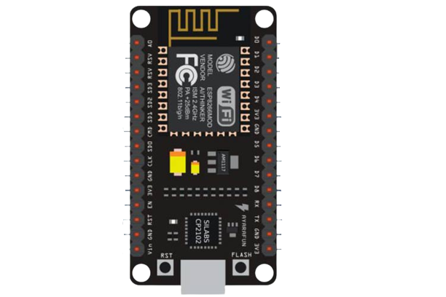

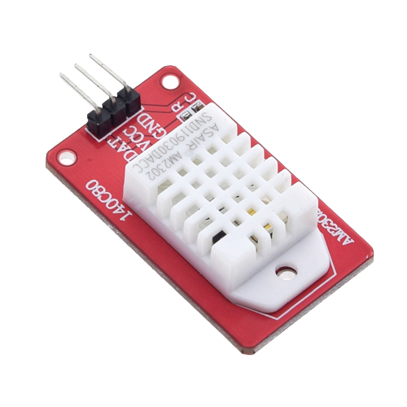
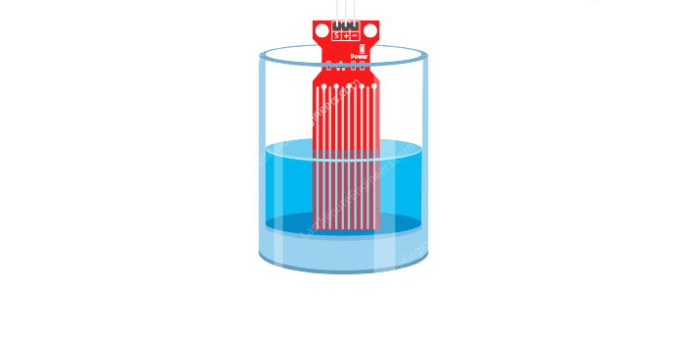
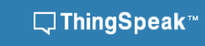

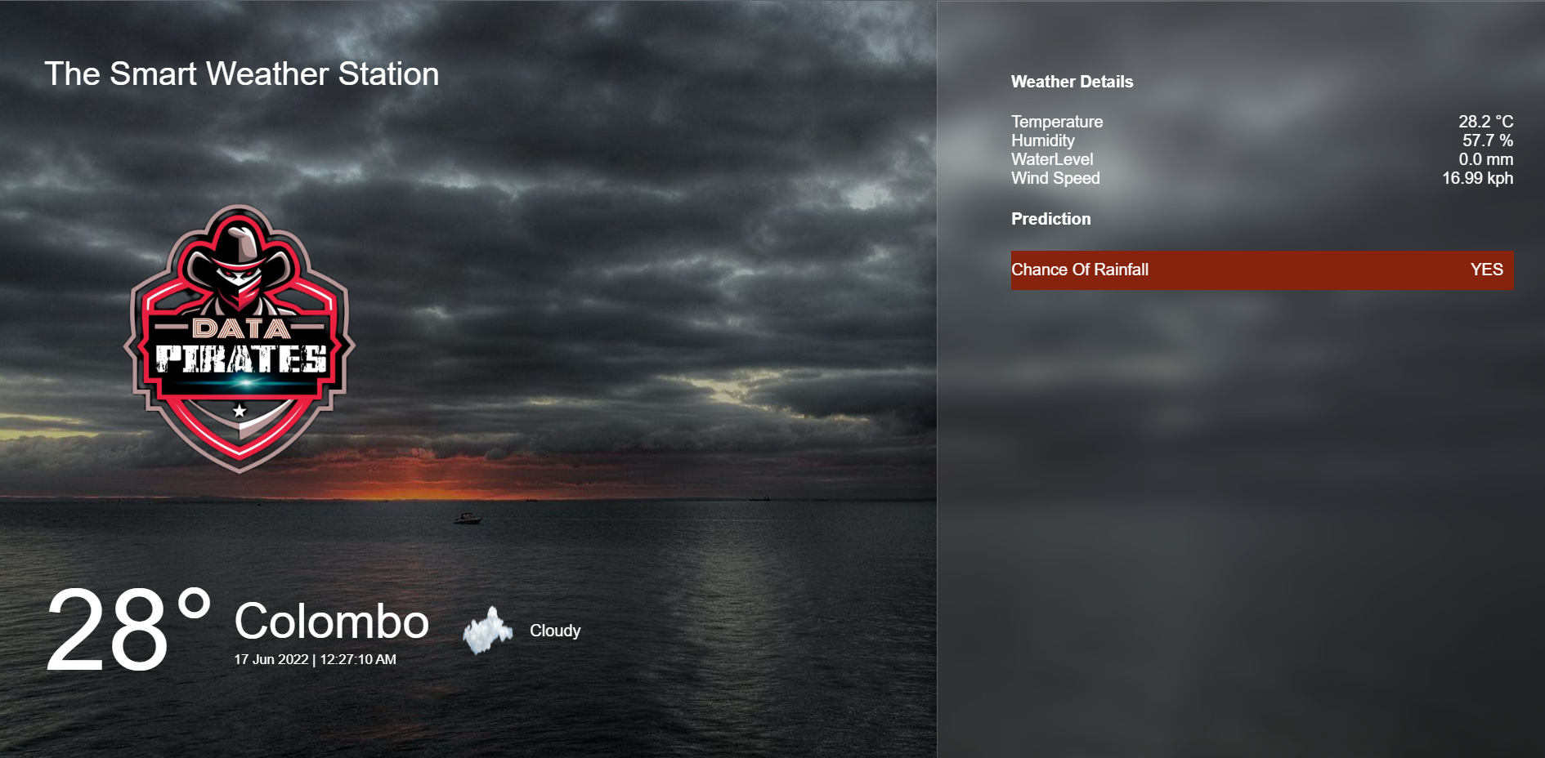



VISUALIZATION

Slide 4
MACHINE LEARNING
145460 rows
23 columns
DATASET
REMOVE DUPLICATES
REMOVE NULL VALUED ROWS
4000 duplicates
Label Encoder
ENCODING
DIVISION OF X AND Y
FIT TRANSFORM
SIMPLE IMPUTER
Y Rain Today
Temperature
Rainfall
Wind Speed
Humidity
CLASSIFICATION MODEL
ACCURACY
PREDICTION

Slide 5
BACK END -

Slide 6
FRONT END – HTML,CSS

Slide 7
THANK YOU!

